Slide 1
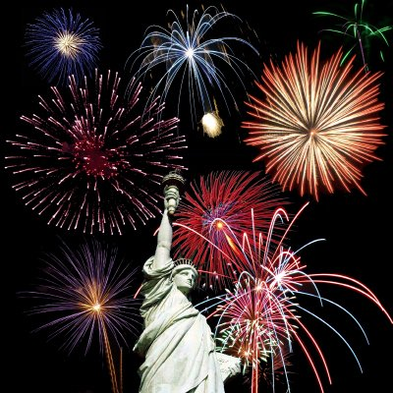
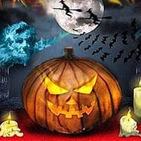
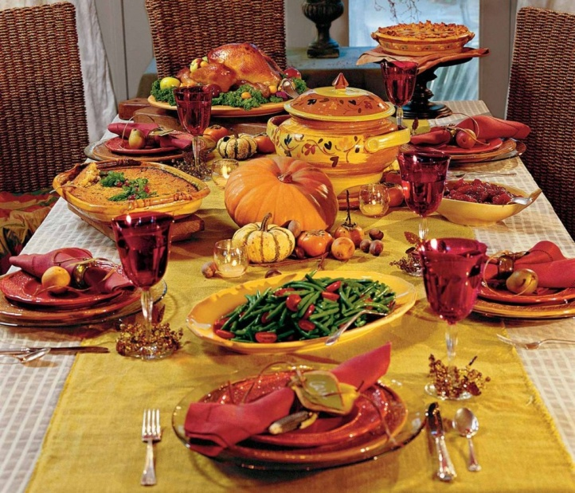
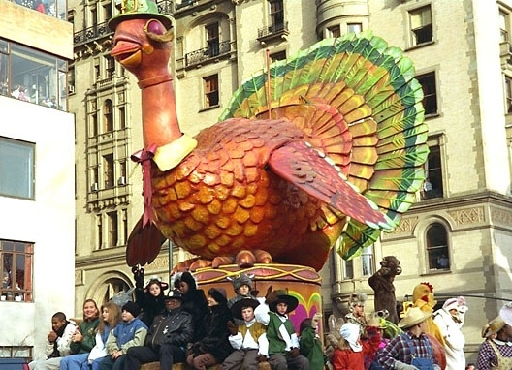
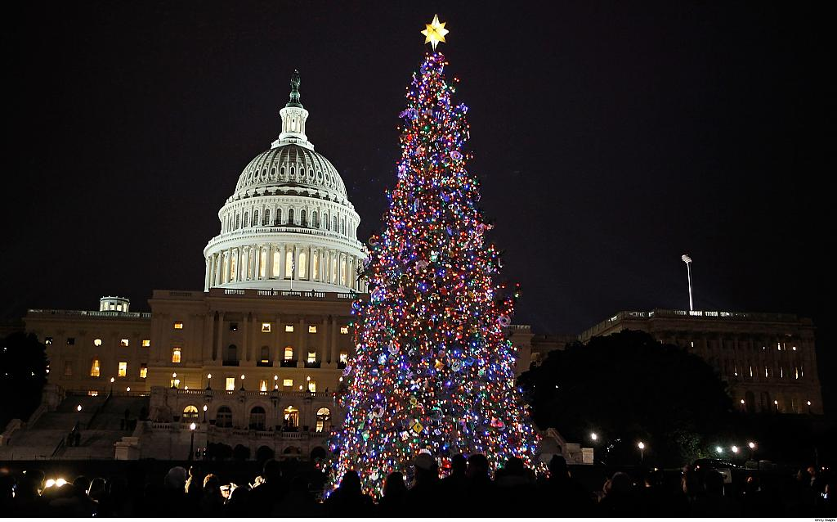
O H I D Y L A S
HOLIDAYS

Slide 2
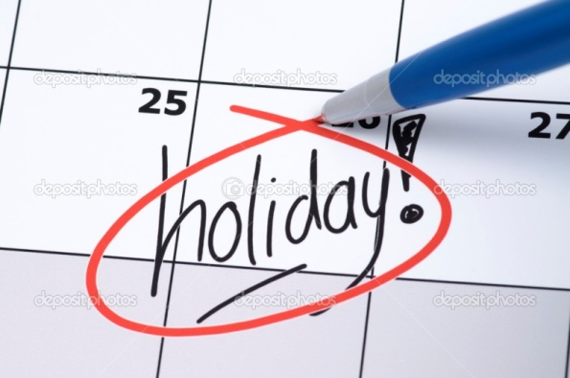
Match the Holidays to their dates
31st October
14th February
1st May
17th March
31st December
4th Thursday of
November
St. Valentine’s Day
New Year’s Day
Halloween
Thanksgiving Day
May Day
St. Patrick’s Day

Slide 3



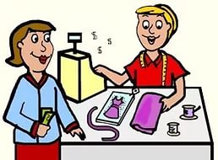
D0 or MAKE
Main meanings of the verb MAKE: create, design, construct, produce.
Main meanings of the verb DO: complete, fulfill some action, perform some activity.

Slide 4
Making Preparations
Fill in: DO or MAKE
MAKE
1 ,,,,,,,,,, the decorations
2 ,,,,,,,,,, the dusting
3 ,,,,,,,,,, your homework
4 ,,,,,,,,,, a phone call
5 ,,,,,,,,,, the gardening
6 ,,,,,,,,,, tea
7 ,,,,,,,,,, a special dish
8 ,,,,,,,,,, the washing-up
9 ,,,,,,,,,, the shopping
10 ,,,,,,,,, a cake
Do
Do
MAKE
Do
MAKE
MAKE
Do
Do
MAKE

Slide 5
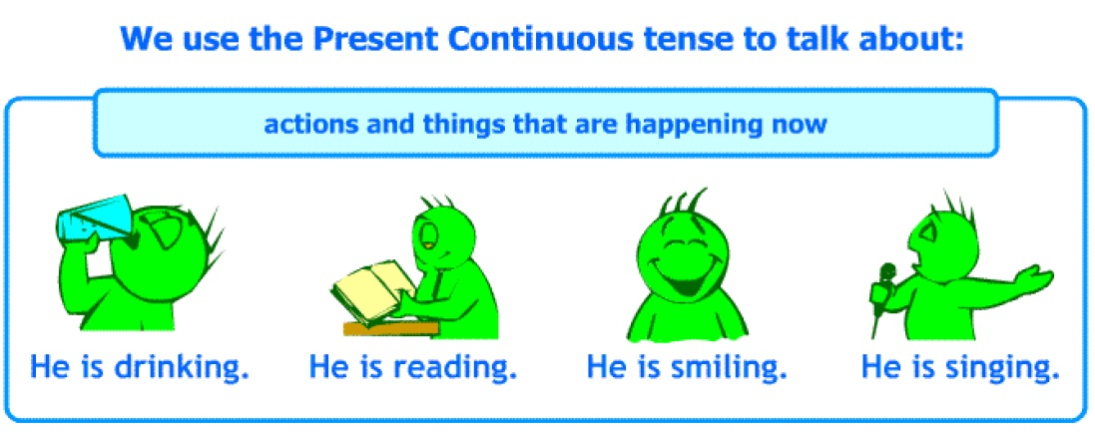
‘to be’
Am
Is
Are
I
He, She, It
You
We
They
Verb + ing

Slide 6
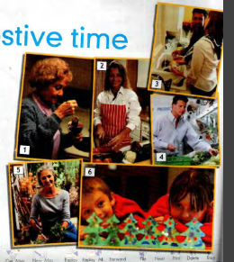
What are the people in the pictures doing?
1. She is making tea
2. She is cookig
3. They are washing up
4. He is doing shopping
5. She is doing gardening
6. They are making decoration

Slide 7
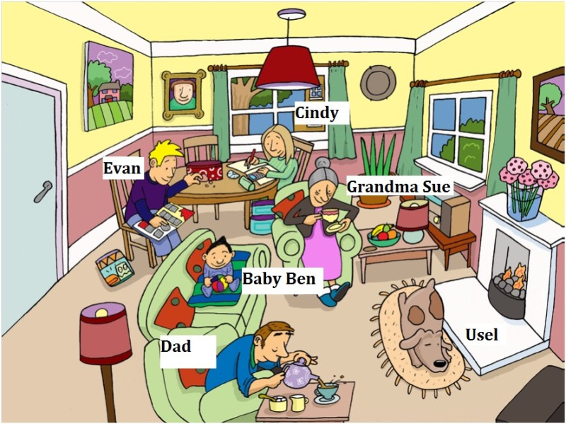
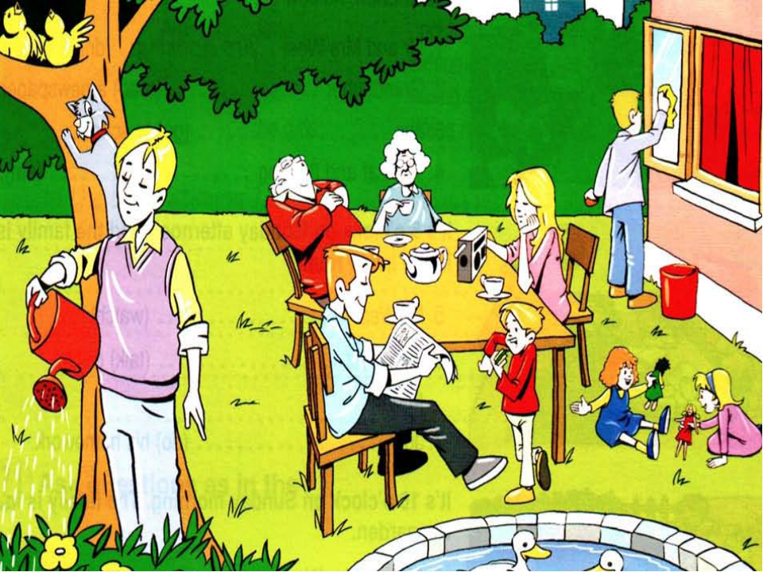
Tommy
Grandpa Sam
Grandma Liz
Bob
Mum
Dad
Alice
Peter
Lucy

Slide 8
Scheme
Topic

Slide 9
It was difficult…
Now I can…
It was interesting…

